Slide 1
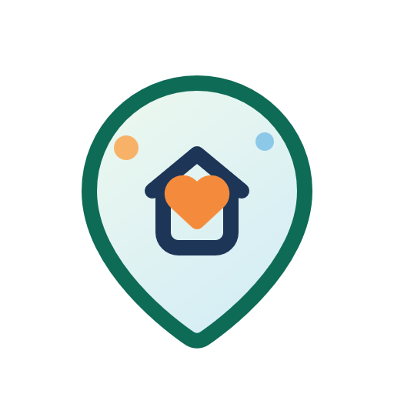
Neighborly
Pitch Deck
Brian Bazurto - Project Lead / Primary Developer / Presenter
Brian Bazurto - Product Owner
Brian Bazurto - Scrum Master / Developer Brian Bazurto - Cross-Functional Developer Brian Bazurto - Tester / QA Reviewer
Notes:
Good morning. My project is called Neighborly. Neighborly is a neighborhood help application designed to make it easier for people to ask for support, offer help, and coordinate everyday tasks inside a local community. The goal is to take the kind of help people already look for in text messages, group chats, and social media posts, and organize it into one focused product experience. For this project I handled the major roles myself, including product ownership, development, testing, documentation, and presentation. In this presentation I will walk through the problem the app solves, the most important product features, and the technical design behind the prototype. I will also show how the app was planned and structured as a software engineering project rather than only as a user interface mockup.

Slide 2

About Neighborly
Background
Neighbors often need quick local help.Those requests are usually fragmented across chats and social media.
Problem
People struggle to find trustworthy local support quickly.
Difference
Neighborly combines requests, offers, discovery, trust, and coordination in one lightweight app.
Notes:
This slide explains why Neighborly matters. People often need practical local help, such as tutoring, rides, errands, or pet care, but those requests are usually scattered across different places. Someone may post in a chat, then repeat the same request in a social feed, and then still have trouble finding a trustworthy person nearby. That fragmentation creates friction, wastes time, and makes local coordination harder than it should be. Neighborly is meant to solve that by giving users one simple place to discover opportunities, post needs, and respond to others. The concept is especially relevant for students, working adults, families, and seniors, because all of those groups may need occasional local support. The app also emphasizes trust signals and clarity, which are especially important when software supports real-world interactions between neighbors.

Slide 3

3Major Features of the Project
1. Requests and Offers
Residents can publish help requests or service offers for tutoring, rides, errands, and pet care.
2. Discovery
Users can search, filter, and browse dedicated Need Help and Can Help boards.
3. Coordination
Inbox previews and listing actions support direct follow-up and scheduling.
Notes:
The product is built around three major feature groups. The first is requests and offers. Users can post when they need help, or they can post when they are available to help someone else. That gives the app a two-sided community model instead of a one-direction flow. The second feature group is discovery. Users should be able to search, filter, and browse specific boards instead of scrolling through unrelated content. That is why the prototype includes dedicated Need Help and Can Help views, along with search and category filtering. The third feature group is coordination. Once a user finds a relevant listing, the app should help them move toward action. For that reason, the prototype includes inbox previews, listing details, and direct paths to continue the conversation. Together, these three areas create a lightweight but complete user journey.

Slide 4
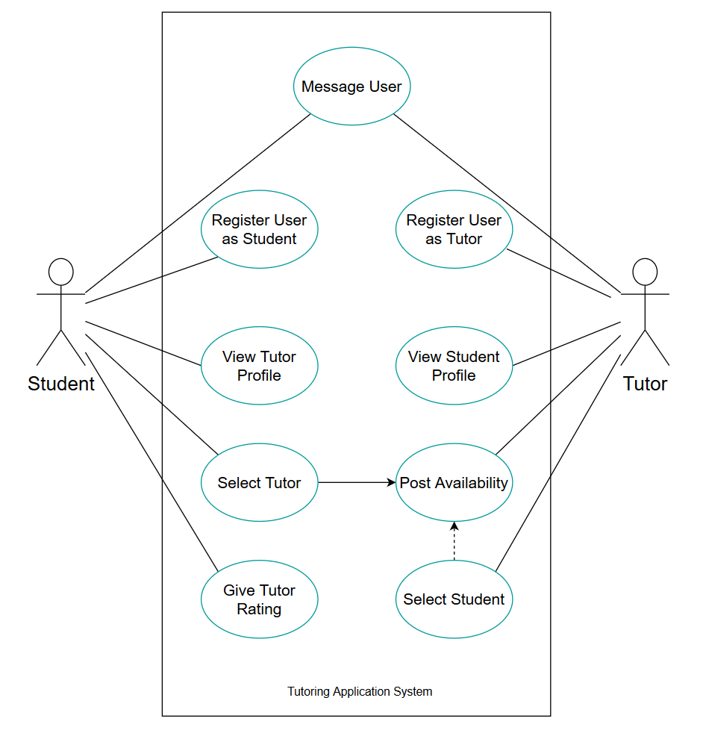
App Use Cases
Use case diagram and flow assets
See deliverables/uml for export-ready source files.
Notes:
This slide represents the main use cases in the system. At a high level, the primary actor is the resident or neighbor using the application. That user can browse the dashboard, search listings, open a request or offer, create a new post, send a message, and review profile or trust details. I wanted the use cases to stay practical and close to what a real person would do. Instead of overcomplicating the model, I focused on the core actions that make the app useful in daily life. That includes posting a request, responding to a listing, and coordinating follow-up through the inbox. The use-case perspective was helpful because it kept the design centered on user behavior rather than only on screens. It also helped make sure the stories, interface flows, and later diagrams all pointed back to the same core product goals.

Slide 5
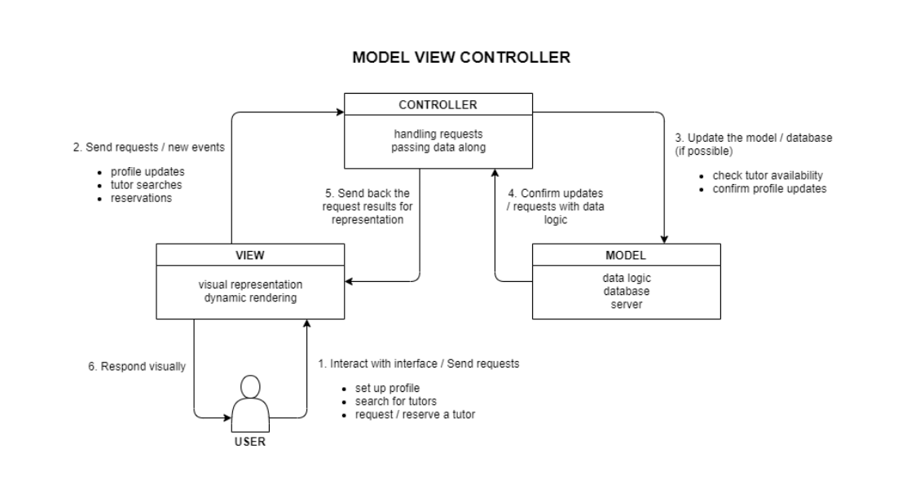
Architecture
Notes:
Architecturally, this prototype uses Flutter so the same codebase can support web, Android, and iOS. That choice was important because it let me demonstrate a modern cross-platform approach while still keeping the semester scope manageable. The app is organized around a presentation-first structure with a welcome flow, a shell for navigation, and separate page widgets for the major feature areas. For reliability, the current prototype uses local sample data instead of a production backend. That decision reduced demo risk and made it easier to focus on engineering documentation, UI behavior, and traceability between stories and features. At the same time, the architecture leaves room for future improvements such as authentication, persistent storage, real-time messaging, and verified profiles. So even though the prototype is intentionally lightweight, it was designed in a way that could be extended later rather than thrown away.

Slide 6
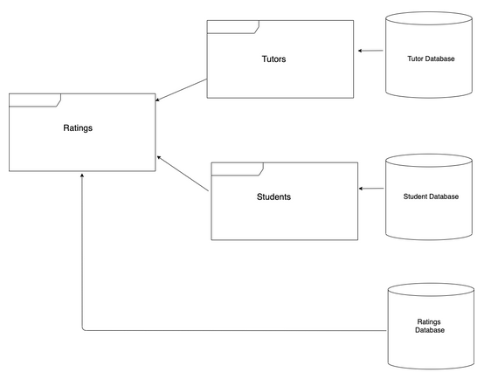
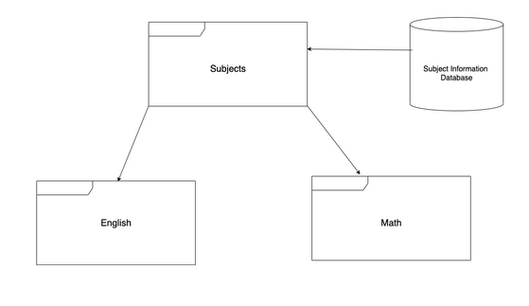
Database Diagram
Notes:
This database view shows the core information the system needs in order to function. The main entities are the user, the listing, the conversation, the message, and the review or trust-related data. A user can create listings, a listing belongs to a category and contains details such as urgency or compensation, and conversations connect users who are coordinating around a listing. I included this model because it clarifies how the app would scale beyond the current mock data. Even in a prototype, it is important to understand what information must be stored and how those records relate to each other. This structure supports the main product behaviors: posting help requests, offering support, discovering listings, messaging another person, and eventually tracking trust or review information. In other words, the data model reflects the product logic, not just the interface.

Slide 7
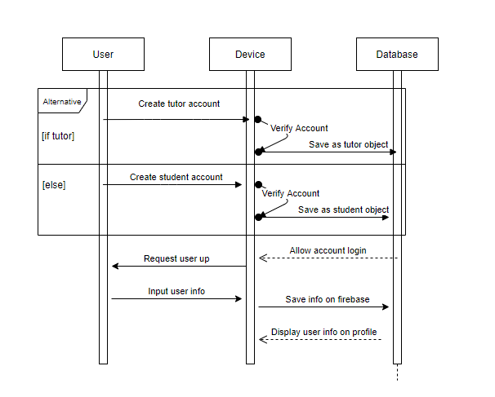
Sequence Diagrams
Login and trust flow
Notes:
This sequence diagram focuses on the login and trust flow. It shows how a user enters the system, moves through the initial access experience, and reaches the main app while seeing trust-oriented cues along the way. Even though the prototype does not use a live authentication service yet, the sequence helps explain the intended behavior and the order of interactions. This is important because access and trust are connected in a community-based product. Users are not only trying to sign in; they are also deciding whether this feels like a safe place to interact with others. That is why the prototype includes visible trust and safety elements early in the experience. The sequence view made it easier to think through what should happen first, what feedback the user needs, and how the onboarding flow should support confidence before the user starts browsing listings.

Slide 8
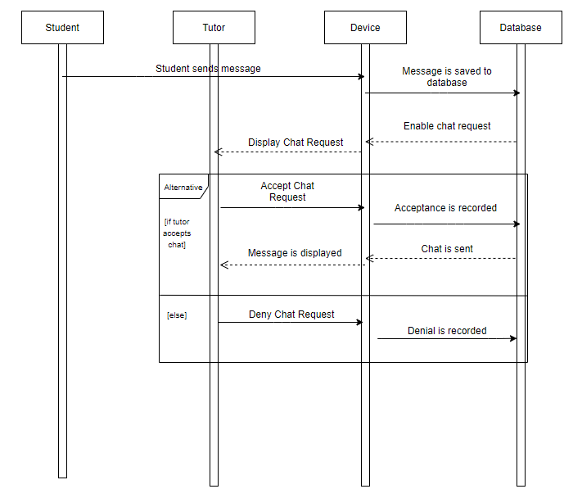
Sequence Diagrams (Cont?d.)
Messaging and coordination flow
Notes:
This continuation focuses on messaging and coordination. Once a user discovers a listing that matches their need or their ability to help, the next important step is moving into direct communication. In the prototype, that means opening the listing details, starting a conversation, and then viewing message previews in the inbox. I wanted this part of the system to feel lightweight and practical. The purpose is not to build a complicated social network; it is to help two neighbors move from interest to action. That is why the sequence emphasizes context, clarity, and continuity. The conversation should still reflect what the listing is about, and the user should be able to return to recent chats without losing track of the coordination. This flow is what turns the app from a browsing experience into a useful problem-solving tool.

Slide 9
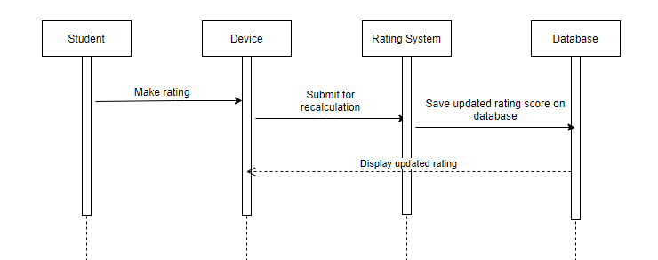
Sequence Diagrams (Cont?d.)
Profile and trust model
Notes:
This sequence highlights the profile and trust model. In a neighborhood-help application, trust is not a side feature. It is one of the main reasons someone will decide whether to respond to another person. For that reason, the profile view includes identity cues, contribution metrics, and safety-focused information that help users feel more confident about the person behind a listing. From a design perspective, I wanted the trust experience to be visible but not overwhelming. The profile should support decision-making without exposing unnecessary sensitive information. That balance is important because the platform needs to feel safe, but it also needs to remain simple and approachable. This sequence helped show how profile information, community participation, and safety reminders can work together to support better local interactions over time.

Slide 10
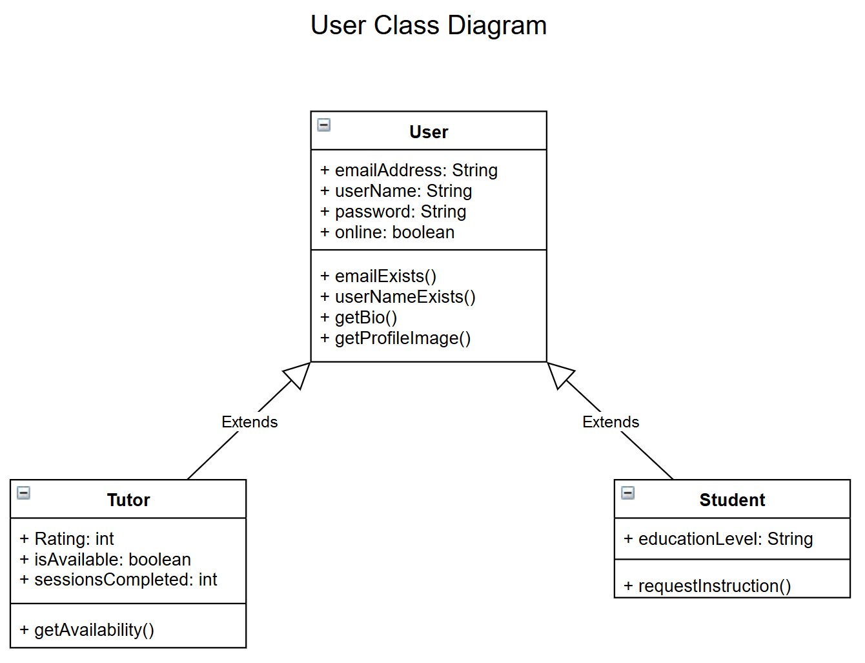
Class Diagram
Notes:
The class diagram shows the main software objects and how the prototype is structured internally. This includes models for users, listings, conversations, categories, and other supporting pieces of state. Looking at the class relationships is useful because it shows that the app is not just a collection of screens. It has a clear underlying structure that supports maintainability and future growth. One of my goals in this project was to keep the code understandable while still reflecting real software engineering thinking. The class relationships help separate responsibilities and reduce confusion between UI concerns and data concerns. That matters if the project were extended later with backend integration, stronger validation, or additional services. In short, this diagram shows how the internal design supports the features I presented earlier.

Slide 11
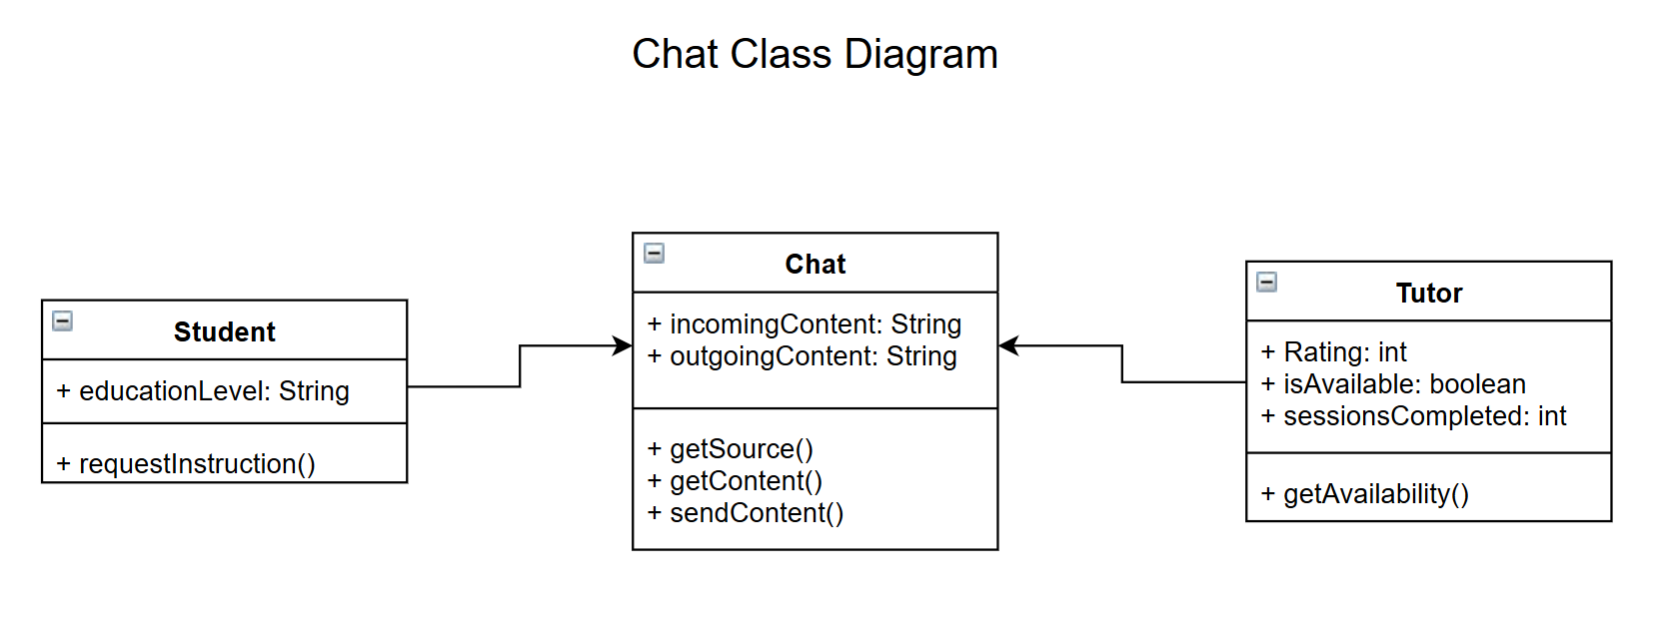
Class Diagram (Cont?d.)
Notes:
This final continuation completes the class and design picture, and it also serves as my closing point for the presentation. Neighborly was designed as a realistic semester project that still demonstrates the full software engineering lifecycle: problem framing, user stories, Scrum planning, UML modeling, implementation, verification, and final presentation. The main value of the project is that it combines a relevant community problem with a structured engineering process. The prototype shows how a neighborhood-help platform could work in practice, while the documentation shows how the idea was analyzed, designed, and validated. If this project continued beyond the classroom, the next logical steps would be live authentication, persistent data, stronger trust verification, and richer community moderation tools. Overall, the project demonstrates both a usable product idea and a disciplined software engineering approach.

